Slide 1
React Native Starter
2026 Edition
Version 0.1.0

Slide 2
Introduction
React Native is an open-source UI software framework developed by Meta Platforms (formerly Facebook Inc.).
React Native allows developers who know React to create native apps. At the same time, native developers can use React Native to gain parity between native platforms by writing common features once.

Slide 3
Why?
Cross-platform applications using a single codebase
Cost Efficiency
Native Performance and Feels
Large Community and Ecosystem
Familiar with Existing Skills

Slide 4
Users
Facebook
Instagram
Airbnb*
Discord
Microsoft
Tesla
More...

Slide 5
Fundamentals
component
JSX
props
state
https://reactnative.dev/docs/intro-react

Slide 6
React JS vs React Native

Slide 7
Code
Tag
  Web: <div> <span> <h1> <img>
  Native: <View> <Text> <Image>
Style
  Web: CSS
  Native: StyleSheet

Slide 8
Example
Web:
<div><h1>Hello World</h1></div>
Native:
<View><Text>Hello World</Text><View>

Slide 9
Example
CSS
  Web: background-color, padding, margin-top, color,...
  Native: backgroundColor, padding, marginTop, color,...

Slide 10
Code
Render
  Web: VirtualDOM
  Native: Platform API via Bridge
Navigation:
  Web: Routes
  Native: Stack

Slide 11
Naming Convetion

Slide 12
Naming Variations
camelCase (thisExampleCamelCase)
snake_case (this_example_snake_case)
PascalCase (ThisExamplePascalCase)
kebab-case (this-example-kebab-case)

Slide 13
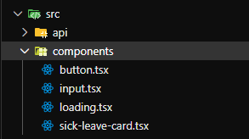
File & Folder
kebab-case
lowercase

Slide 14
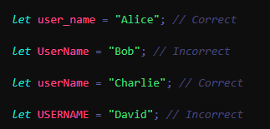
Variable Name
camelCase
snake_case & lowercase

Slide 15
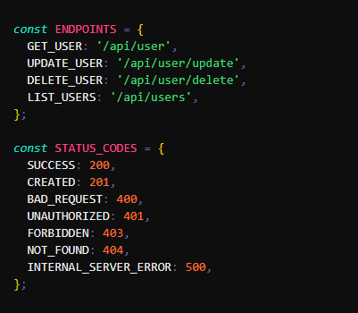
Constants
UPPERCASE
SNAKE_CASE

Slide 16
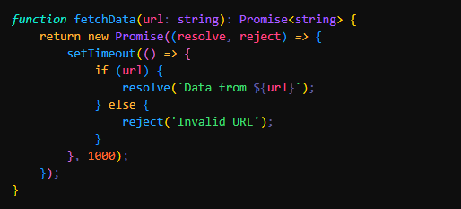
Function Name
camelCase

Slide 17
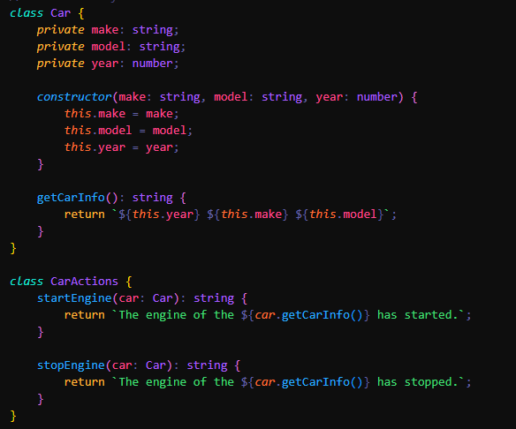
Class Name
PascalCase

Slide 18
File & Folder Structure
Feature-based
Reusable
Consistent
Structured
Clean
Scalable & Maintainable

Slide 19
Installation
https://reactnative.dev/docs/set-up-your-environment
Requirements:
  Node JS [Latest LTS]
  Android Studio [Latest]
    SDK, Build-tools, Android Debug Bridge (adb), Android Virtual Device (avd) (optional)
  Java JRE & JDK [Versi 17]
  Xcode (IOS) [Latest]

Slide 20
React Native
Expo VS CLI

Slide 21
Expo
Easy Setup
Manage Workflow
Use available build-in library
Build & Deploy via Uses Expo Application Services (EAS)
Over-the-Air (OTA) Updates
Larger App sizes

Slide 22
CLI
Manual setup
Access to more complex setup and customization
Full Native Access
Full Controll
Smaller App sizes

Slide 23
Develoment

Slide 24
Device
AVD/Emulator
  AVD Manager (Android)
  Emulator Xcode (IOS)
Real Device
  USB Debugging
  Wireless Debugging

Slide 25
Android USB Debug
adb devices

Slide 26
Android Wireless Debug
Connect to Device
  adb connect 192.168.1.1:12345
Disconnect to Device
  adb disconnect 192.168.1.1:12345
Show Device List
  adb devices

Slide 27
Running Project
npm install (first time)
Start Metro Server (required)
  npm run start
Install & Run
  npm run android/ios
Reconnect without reinstall
  adb reverse tcp:8081 tcp:8081

Slide 28
Generate APK
Debug
  cd android
  ./gradlew assembleDebug
  cd ..
Release
  cd android
  ./gradlew assembleRelease
  cd ..
Result: android/app/build/outputs/app/build/outputs/apk/<debug/release>/app-<debug/release>.apk

Slide 29
Release Bundle Android
cd android
./gradlew bundleRelease
cd ..
Result: android/app/build/outputs/bundle/release/app-release.aab

Slide 30
Signed APK
Generate Key
  keytool -genkeypair -v -keystore my-release-key.keystore -alias my-key-alias -keyalg RSA -keysize 2048 -validity 10000
  Result: `my-release-key.keystore` in `android/app/`
https://reactnative.dev/docs/signed-apk-android

Slide 31
Demo

Slide 32
Thank You;

